Slide 1
Virtual Reality , Augmented Reality , NFT’s
VR:Virtual reality is the use of computer technology to create simulated environments. Virtual reality places the user inside a three-dimensional experience. Instead of viewing a screen in front of them, users are immersed in and interact with 3D worlds.
AR: Augmented reality (AR) is an enhanced version of the real physical world that is achieved through the use of digital visual elements, sound, or other sensory stimuli delivered via technology.
NFT’s: An NFT is a digital asset that represents real-world objects like art, music, in-game items and videos. They are bought and sold online, frequently with cryptocurrency and they are generally encoded with the same underlying software as many cryptos.

Slide 2
Various technologies
Software | Purpose | Description
Unity | Virtual reality | can create VR solutions for automotive, transportation, manufacturing, media & entertainment, engineering, construction, etc. with Unity.
Blender | Virtual Reality | free and open-source 3D computer graphics software toolset used for creating animated films, visual effects, art, 3D-printed models, motion graphics, interactive 3D applications, virtual reality, and, formerly, video games.
Amazon Sumerian | Virtual Reality | Sumerian works with all popular VR platforms like Oculus Go, Oculus Rift, HTC Vive, HTC Vive Pro, Google Daydream, and Lenovo Mirage, moreover, it works with Android and iOS mobile devices too
Unreal Engine 4(EU4) | Virtual Reality | With UE4, you can build VR apps that will work on a variety of VR platforms, e.g., Oculus, Sony, Samsung Gear VR, Android, iOS, Google VR, etc.
Vuforia | Augmented Reality | Vuforia offers a range of products for developing AR experiences, including Vuforia Engine, Studio, and Chalk.
Wikitude | Augmented Reality | Wikitude is suitable for developing AR apps for iOS, Android, and Smart Glasses devices. Wikitude supports a variety of tracking methods and technologies, but also incorporates geolocation, cloud recognition, and distance-based scaling features.
ARKit | Augmented Reality | ARKit is the go-to application for the development of AR software developed by Apple. The software relies on camera sensor data and additional data to detect and analyze users’ surroundings for AR visualization.

Slide 3
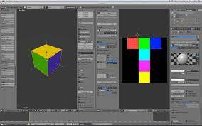
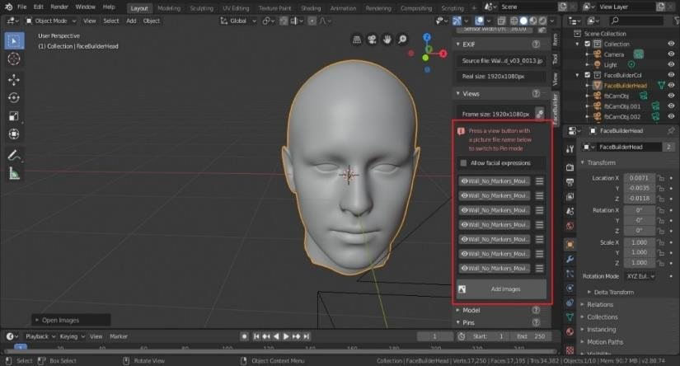
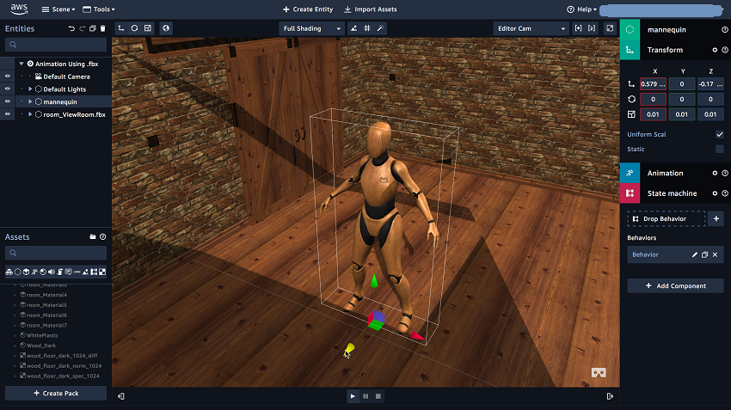
Use Cases/Output samples:
Blender:
Amazon Sumerian:

Slide 4
Characteristics/Features
Park Recreation
Hoarding
Sports Complex
Parking
Building housing
Commercial complex
These all can occupy the empty region present in Hyderabad area.

Slide 5
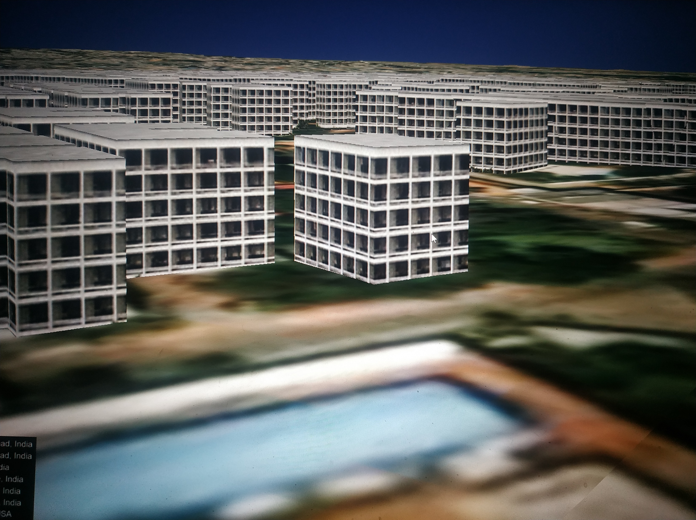
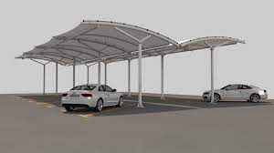
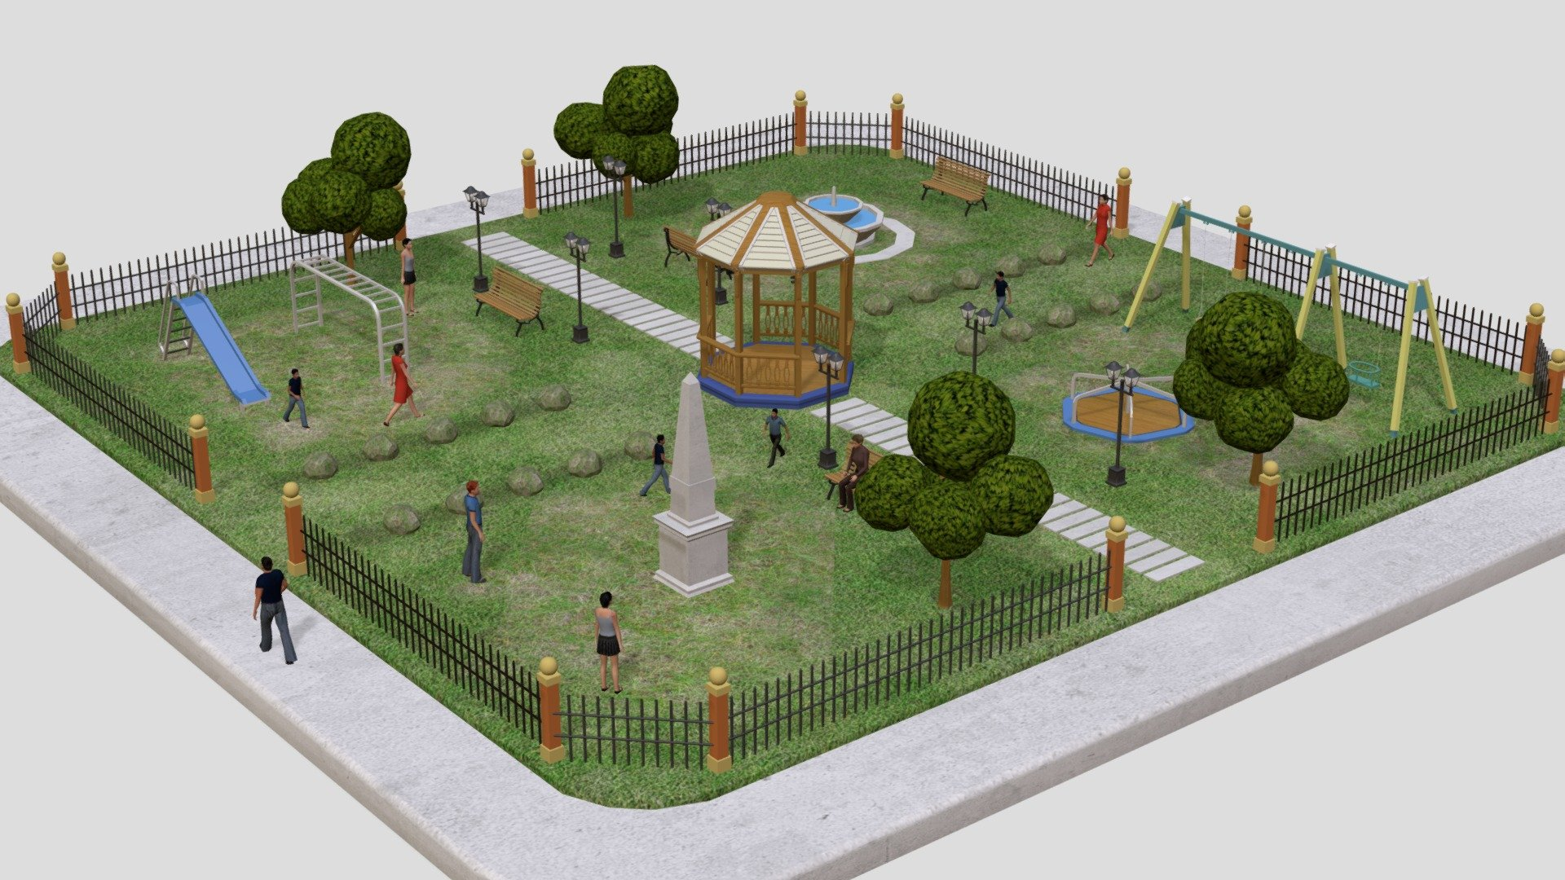
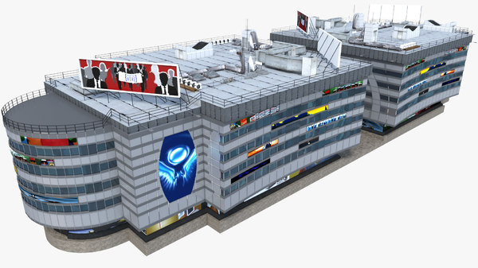
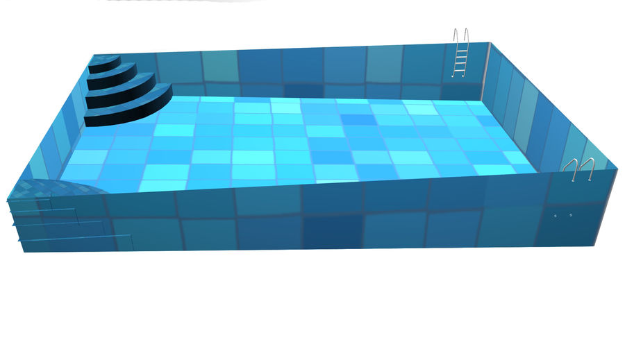
Park
Belongs to Mr. C
Area: 3000sqft
Parking
Belongs to Mr. F
Shopping complex
Belongs to Mr. A
Area:8500sqft
Swimming pool
Belongs to Mr. B
Area:600sqft

Slide 6
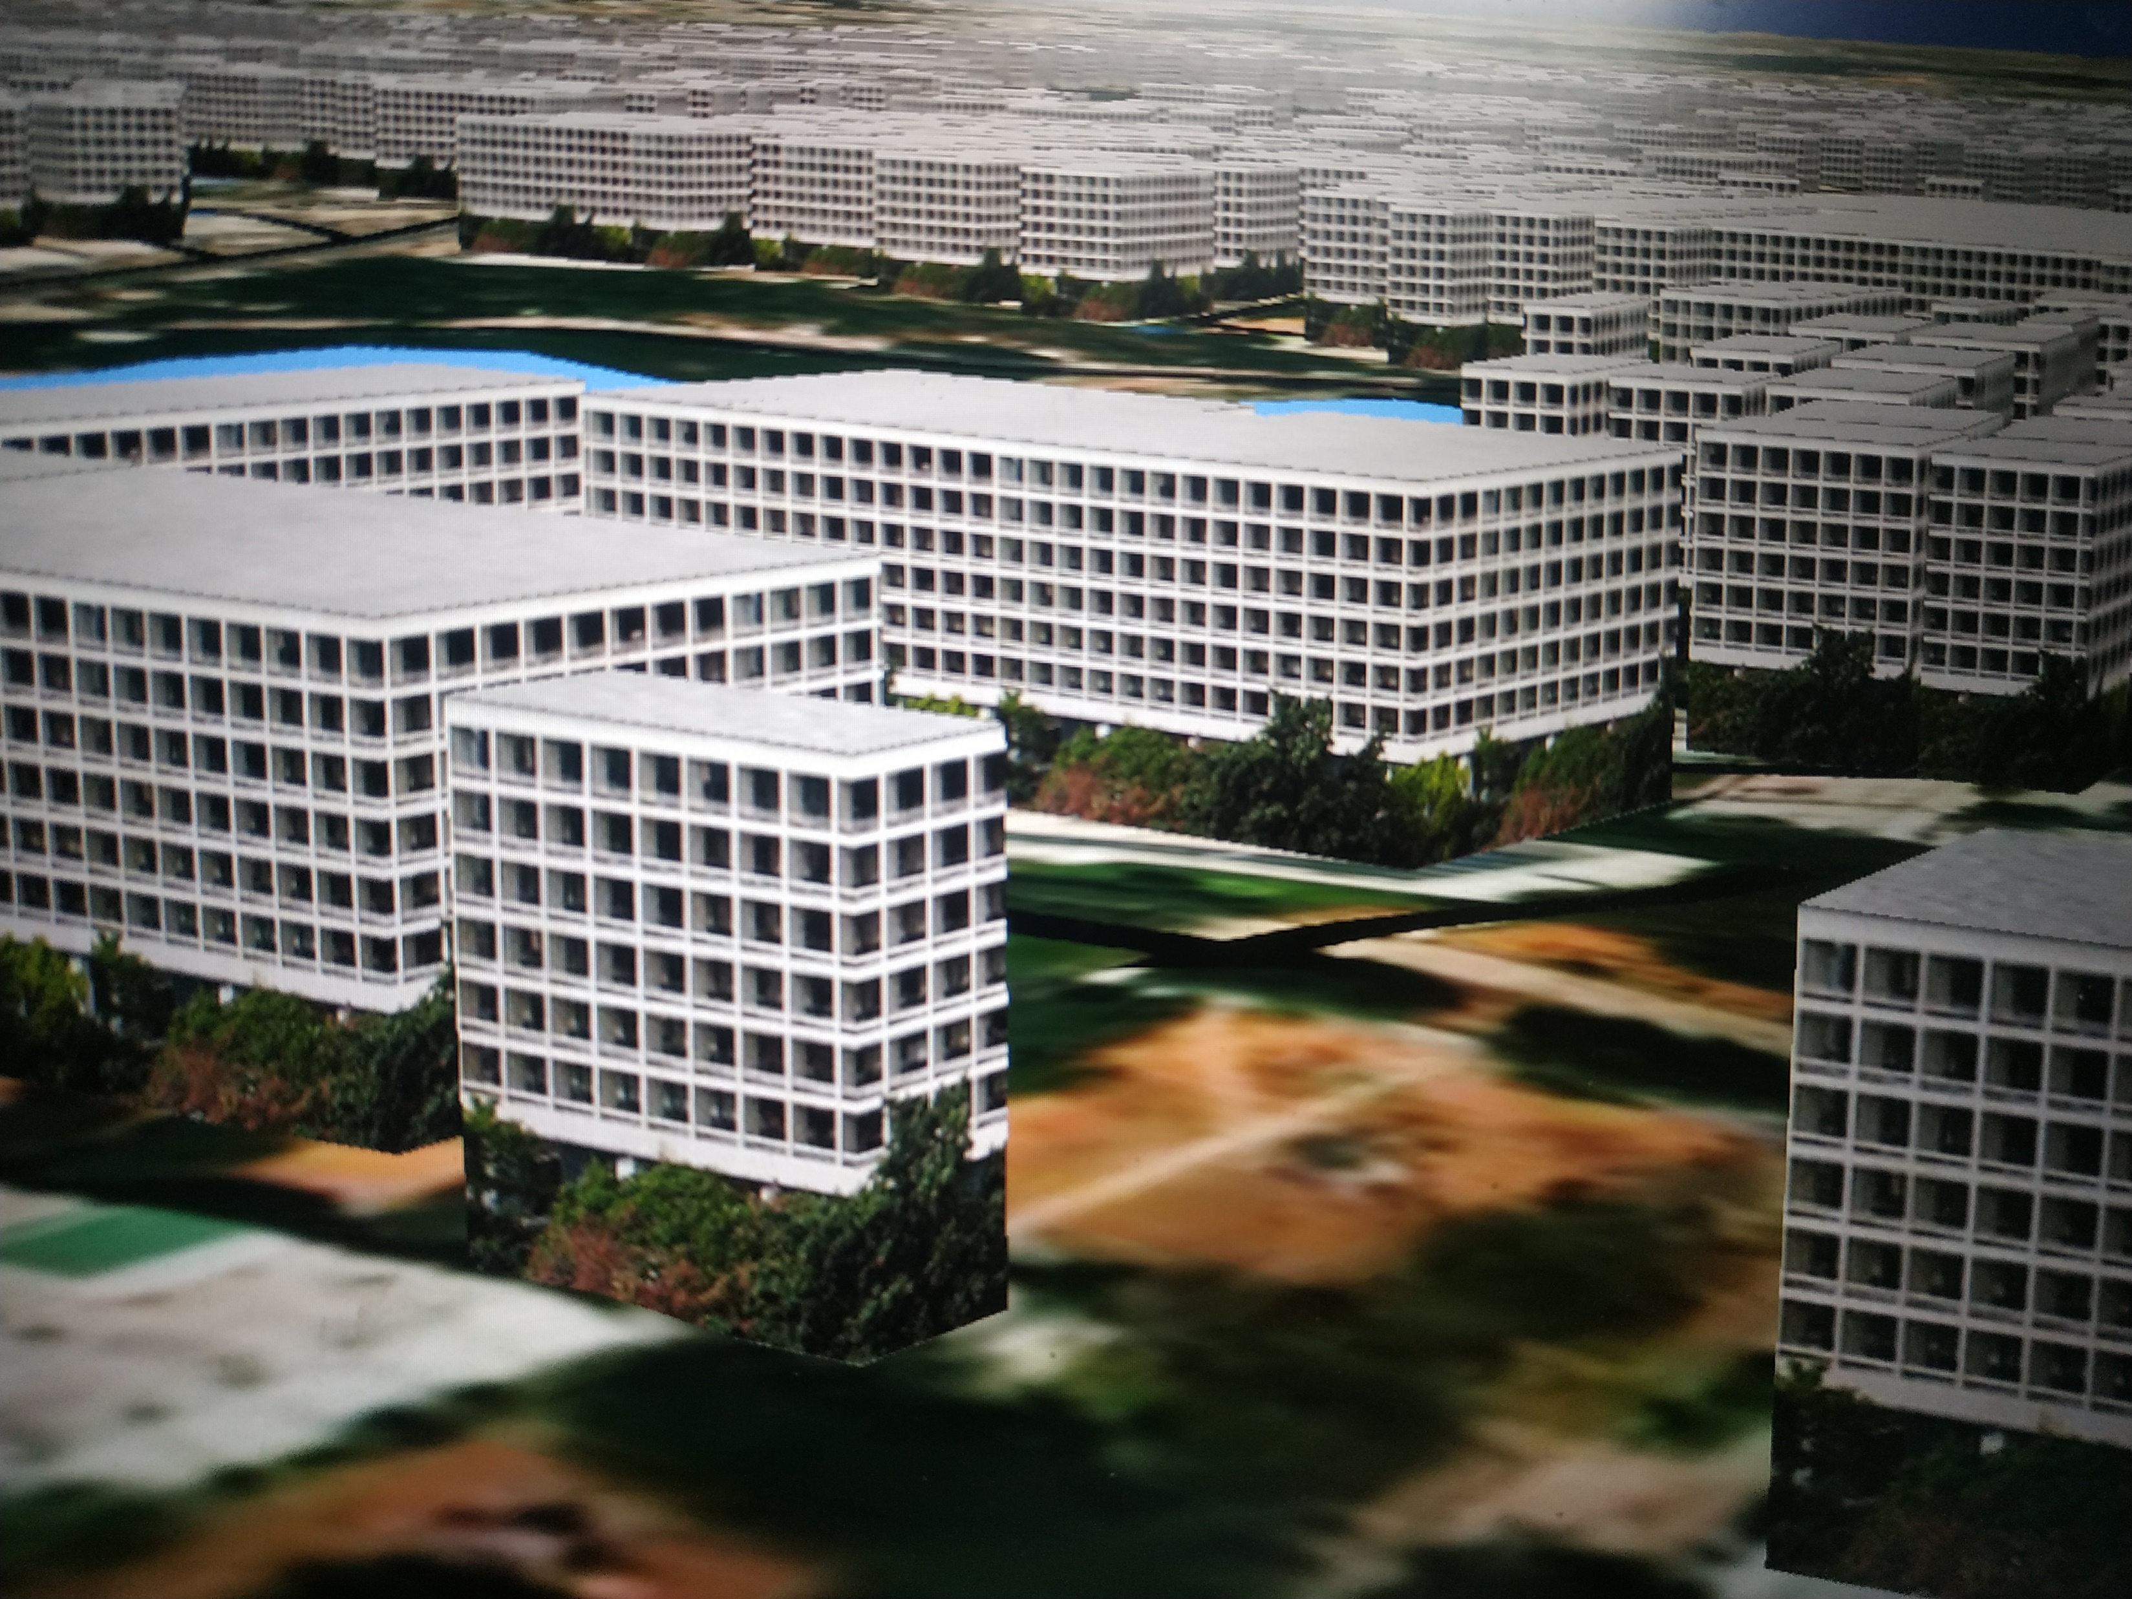
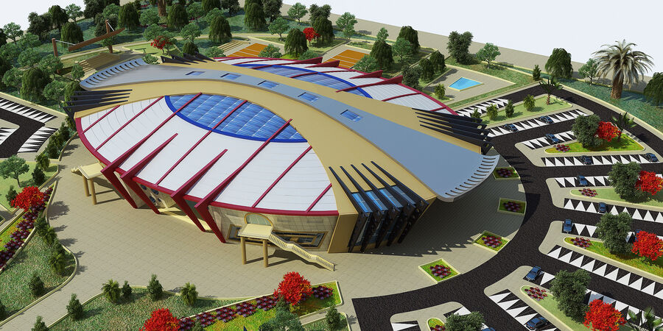
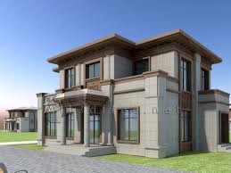
Sports complex
Belongs To Mr. D
Area: 5000sqft
House
Belongs to Mr. E
Area: 1800sqft

Slide 7
Buying Characteristics with NFTs like using Auctioning
People can buy the area in Sqft through NFT’s and can choose any of the features/characteristics.
If they want to sell what they previously bought that can be put in the auction and the person with highest bid will get that feature.
For example consider Mr.C wants to sell his park so the park will be put in auction.
In the auction through NFT Mr. A buys the park where he already owns shopping complex.
Now Mr.A owns both park and shopping Complex.
Mr. C will be left with nothing.

Slide 8
Characteristics after auction
Park
Belongs to MR.A
(recently bought in auction)
Parking
Belongs to Mr. F
Shopping Complex
Belongs to Mr.A
Swimming pool
Belongs to Mr.B

Slide 9
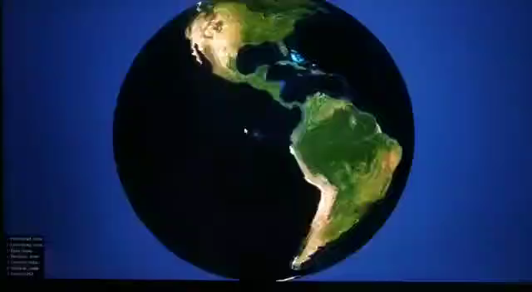
Osgearth(video)

